Slide 1

DEPRESSION DETECTION APP
PROF. HENRY WONG CS 692

Slide 2

AGENDA
1
Project Description and problem statement
2
Description of minimal viable product and all attributes,
including product backlog
3
Acceptance Criteria & user stories
4
Sprint 7 backlog and test cases
5
Team metrics for every sprint
6
Application screenshot & ML model description
7
API and Retrospective & plans for future development

Slide 3

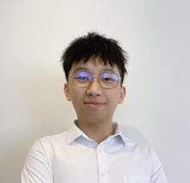
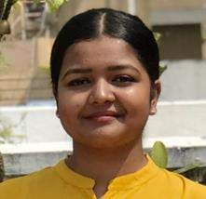
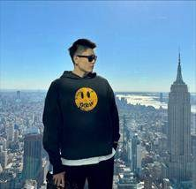
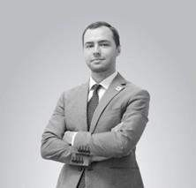
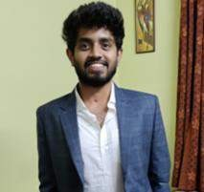

OUR TEAM
Omkar Shitole Developer & DBA
Yuxiang Liu Lead Software Engineer
Shivani Chavan Developer
Wangbo Gu Developer
Artem Kolmogorov Developer & Project Manager
Siddarth Ravirala Developer

Slide 4


IMPROVEMENTS MADE FROM PROFESSOR’S FEEDBACK
IMPROVEMENT OF TEAM VELOCITY AND SPRINT
BURNDOWN CHARTS
We have improved burndown chart with story points using only Fibonacci numbers as well as introduced ideal burndown line (Slide 42).
IMPROVEMENT OF PROBLEM STATEMENT AND
PROJECT DESCRIPTION
We have reduced the size of problem statement and project description leaving only essential parts in. (Slide 6, 7).

Slide 5
PROJECT DESCRIPTION
Project Name StressOut
Team Bug Terminator
Project Description Detecting early signs of depression based on users' pictures and quizzes
For customers
Who want to manage their mental health The StressOut app
Is a mobile app
That analyzes user’s images and quiz results and provides accurate assessment
Unlike traditional way of visiting specialists.
Our application provides accessible, accurate and daily measurement of person’s
mental state
Benefit Outcomes
Users can check their mental state anywhere and anytime
Users can track their mental state over long period of time
Users can receive useful tips for managing depression
Github Link
https://github.com/htmw/2023S-Team2

Slide 6
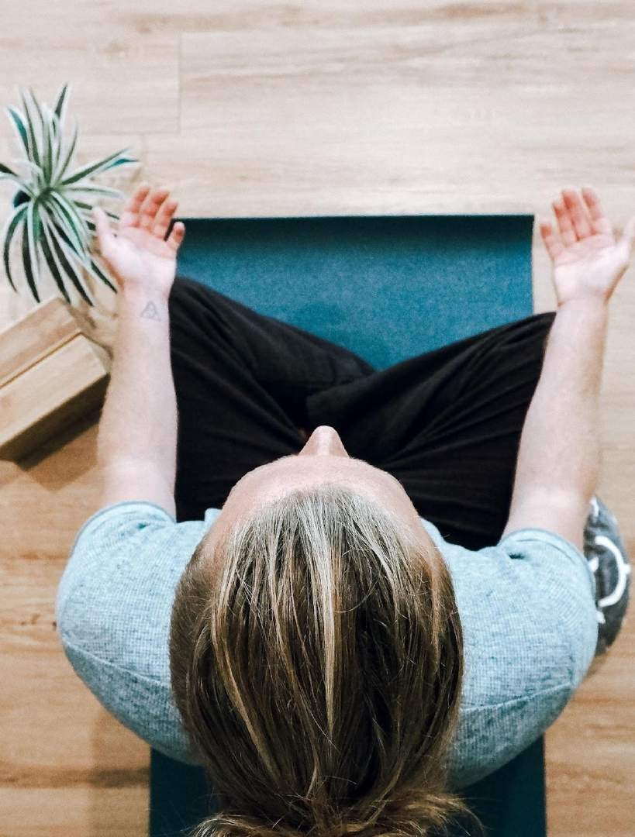
PROJECT DESCRIPTION
We are developing depression detection system that uses artificial intelligence model to analyze person’s face with images or current mood with text, to help find depression sings. Our detection system is trained with a unique dataset depression faces from messages and images. We believe that certain linguistic traits can be examined and linked to possible depressive symptoms as well as used to forecast self-destructive behavior. The training result we want to achieve is the system capable of analyzing the input (messages and images) from users, and detect the type of depression such as anxiety, bipolar or paranoia.

Slide 7
PROBLEM STATEMENT
Depression is a prevalent mental health disorder that affects millions of people worldwide. The condition is characterized by a persistent feeling of sadness, hopelessness, and loss of interest in daily activities. It significantly impairs a person's ability to function and can lead to a range of physical and emotional problems. Early detection of depression is crucial for effective treatment, as it can reduce the severity and duration of symptoms and improve a person's quality of life.
However, traditional methods of detecting depression, such as self-report questionnaires or clinical interviews, have several limitations. Self-report questionnaires rely on a person's ability to accurately report their symptoms, which can be influenced by various factors, such as social desirability bias, memory recall bias, and language barriers. Clinical interviews can also be subjective and may vary depending on the clinician's experience and training.
As a result, there is a need for an objective and reliable method of detecting depression. One potential solution is the use of machine learning algorithms to analyze various data sources, such as speech patterns, facial expressions, and physiological signals, to identify indicators of depression. By developing accurate and reliable detection systems, we can improve the lives of millions of people who suffer from depression worldwide.

Slide 8


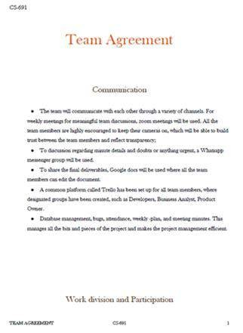
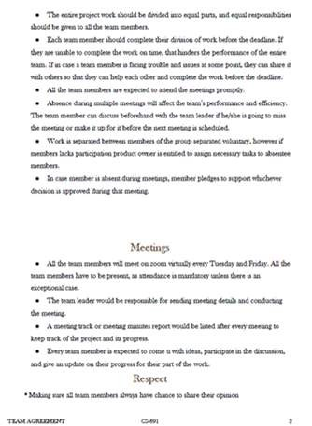
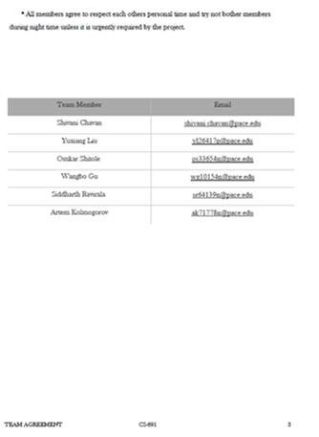
TEAMWORK AGREEMENT
SUBTITLE HERE

Slide 9

PERSONAS
JACK
Profile
Jack, a 35-year-old software engineer who has a history of depression and anxiety. He often finds himself feeling overwhelmed at work and is struggling to balance his job and personal life. He wants to find a way to manage his symptoms so that he can be more productive and happier.
Name: Jack Age: 35
Location: Chicago, MI Job: Software Engineer
Salary: 92 000 – 110 000$/annually Family: Single
Interests
Riding Bike
Goes Kayaking
Attending live concerts
Goals
Moving to south
Finding friends
Buying a bigger house
Frustration
Managing depression
Wants to change job, but unable

Slide 10
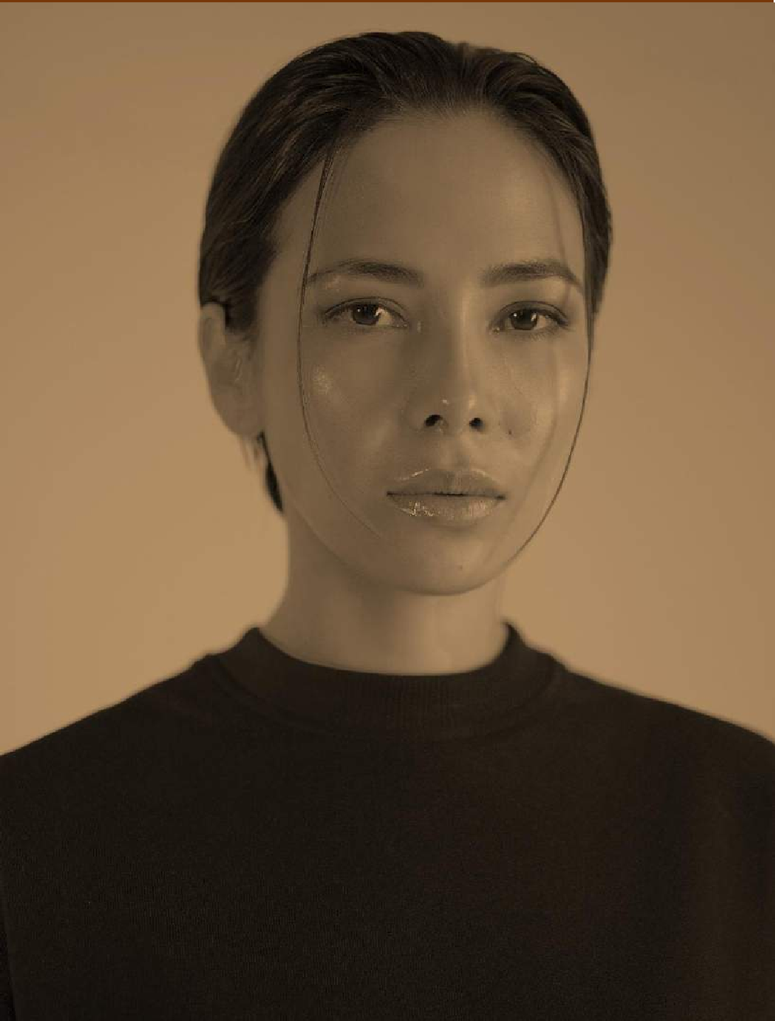
PERSONAS
SARAH
Profile
Sarah, a 25-year-old graphic designer who has
been feeling down for the past few months. Despite her successful career and supportive friends and family, she feels unfulfilled and struggles to find joy in her everyday life. She wants
to find a way to manage her depression and is open to using technology to help her do so.
Name: Sarah Age: 25
Location: Los Angeles, CA Job: Graphic Designer
Salary: 66 000 – 70 000$/annually Family: Single
Interests
Writing own comic books
Everyday swimmer
Loves animals
Watching series
Goals
Buying her own house
Building lifelong relationships
Finding friends
Frustration
Traffic in Los Angeles area
Living alone for a long time

Slide 11

PERSONAS
LISA
Profile
Lisa, a 40-year-old stay-at-home mom who is
feeling overwhelmed and exhausted. She is struggling to keep up with the demands of taking care of her children and household, and she often feels like she is failing as a mother. She wants to
find a way to manage her stress and feelings of inadequacy.
Name: Lisa Age: 40
Location New-York, NY Job: Unemployed Salary: N/A
Family: Married, two kids
Interests
Reading romantic novels
Going for beach holidays
Loves animals
Watching series
Goals
Taking dog from shelter
Helping kids with college
Frustration
Her husband going for a long business trip
Having troubles with her kids

Slide 12
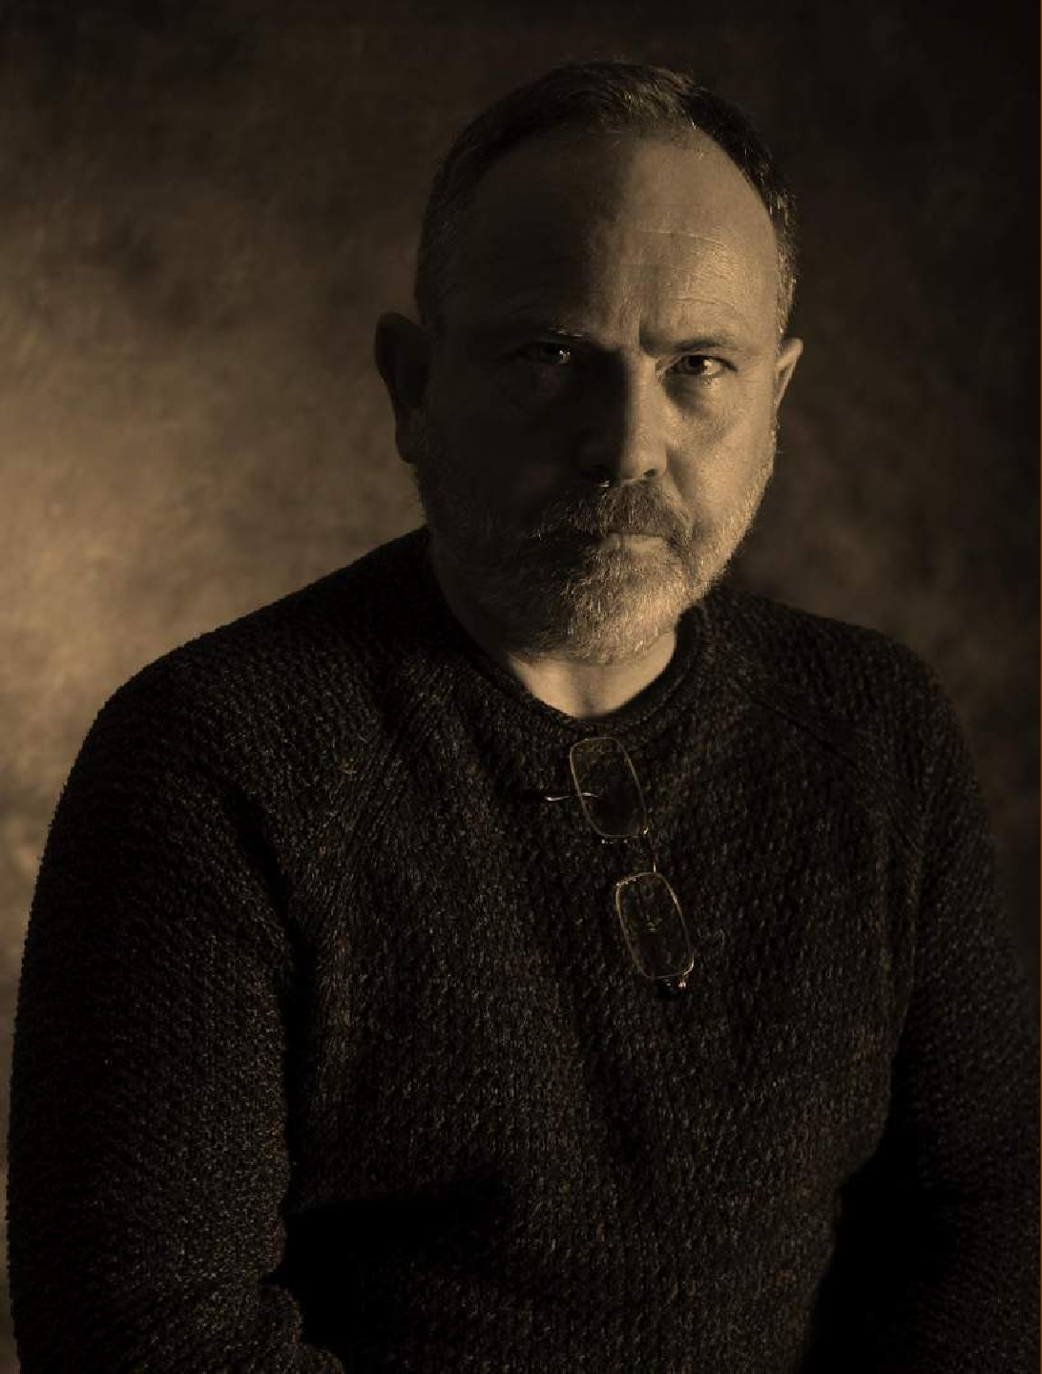
PERSONAS
TOM
Profile
Tom, a 50-year-old small business owner who is feeling stressed and burnt out. Despite the success of his business, he is feeling overwhelmed by the responsibilities and pressure of running it. He wants to find a way to manage his stress and anxiety so that he can enjoy his success and have a better work-life balance.
Name: Tom Age: 50
Location: Austin, TA Job: Self-Employed
Salary: 150 000 $/annually Family: Divorced
Interests
Going hunting & fishing
Taking rides in his chopper
Goals
Building strong portfolio for his 401-k
Finding new friends
Frustration
Declining business profits
Having health problems

Slide 13
MVP, TECHNOLOGIES & ALGORITHMS

Slide 14
MINIMAL VIABLE PRODUCT
Home Page
Profile/History of Consultation
A welcome message that briefly introduces the app and its purpose
A button or link to create an account or log in if you already have one
A list of features and resources available within
the app, such as self-assessment questionnaires,
mood trackers, and mental health resources
A prominent call-to-action encouraging users to take a self-assessment or start tracking their mood
A section where you can edit your personal information, such as your name, email address, and password

Slide 15

MINIMAL VIABLE PRODUCT
Image upload/Take Picture
Recommendation
A camera button that allows you to take a picture
directly within the app
A gallery button that allows you to upload pictures from your camera roll
An option to add captions or notes to each image,
to help you remember important details or context
A dashboard that displays any recommendations or next steps based on your self-assessment results, including suggestions for lifestyle changes, self-care practices, or professional treatment options

Slide 16
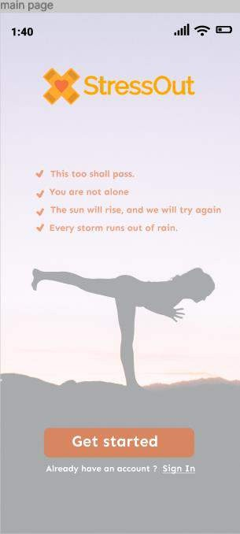
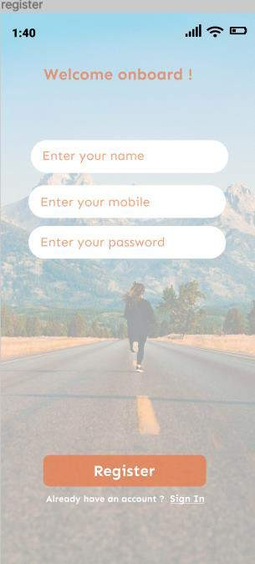
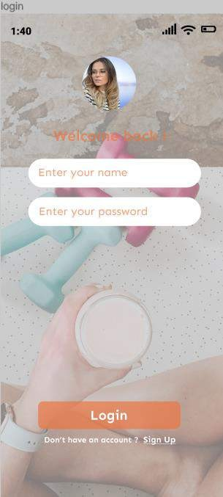
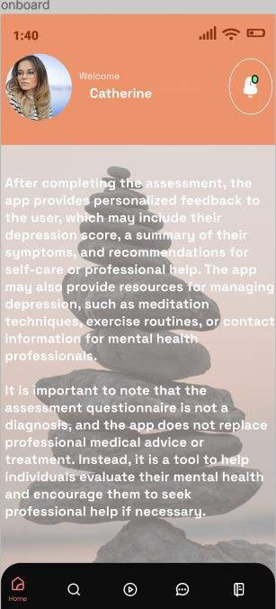
PROTOTYPE

Slide 17
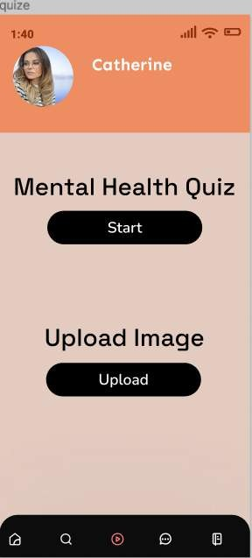
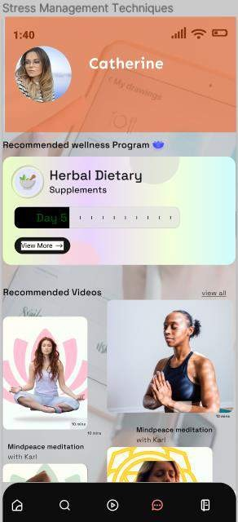
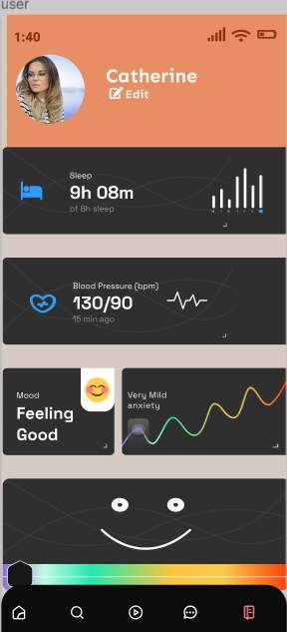
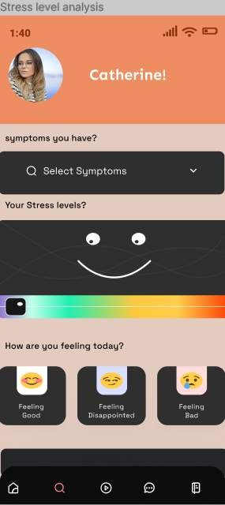
PROTOTYPE

Slide 18








ALGORITHMS & TECHNOLOGIES

Slide 19

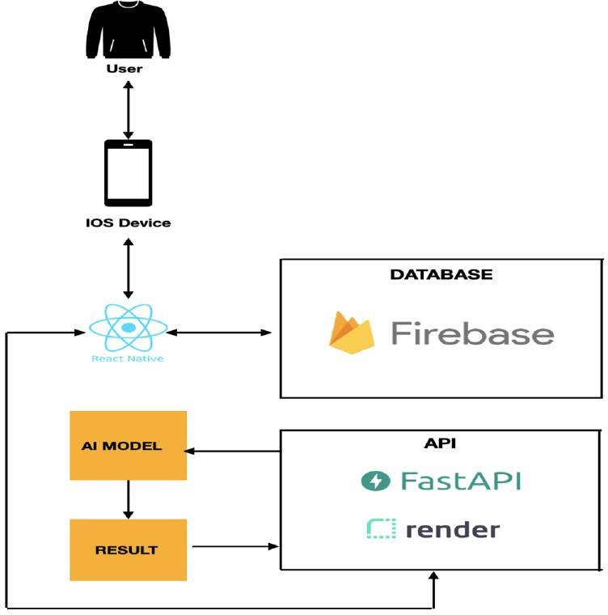
CONCEPTUAL ARCHITECTURE DIAGRAM

Slide 20

SEQUENCE DIAGRAM
Face Recogniti on
Captu re Face Image
Send image for analys is
Analy ze image
Return Analysi s
API
Displa y Instru ction
Display Camera Viewfin der
Display Progres s indicat or
Open App
Positi on Face
Displa y Result
Displa y History
Stress out app
Click “Delet e Histor y”
Delet e Histo ry
Click Click Open “Ope “Star App n t
Test” Test”
Choo se Actio n
Perfor m action
Click “View History”
Confir m action
Use

Slide 21
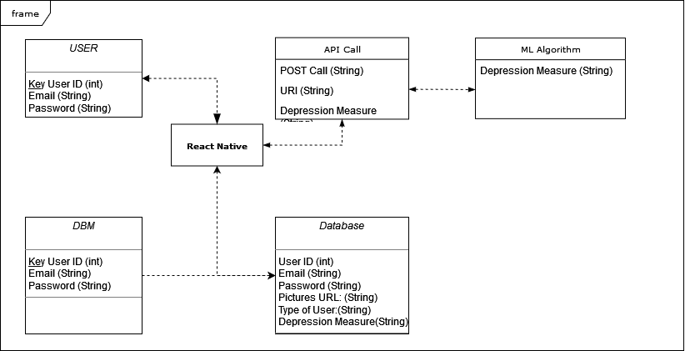
UML CLASS DIAGRAM

Slide 22
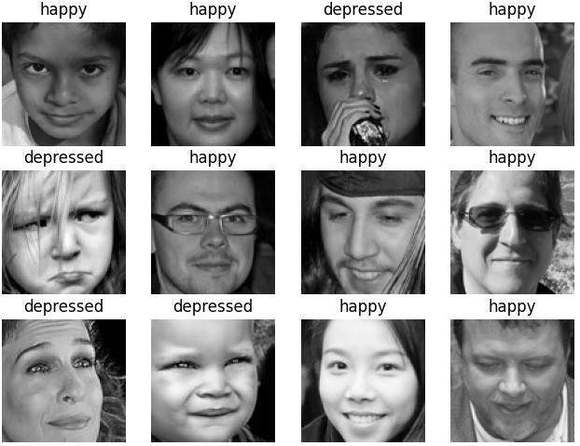
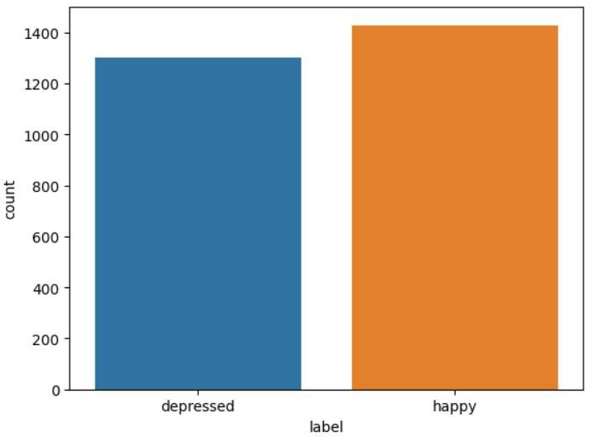
Machine Learning Model
Dataset contains over 2700 facial images
Classified by happy or depressed

Slide 23
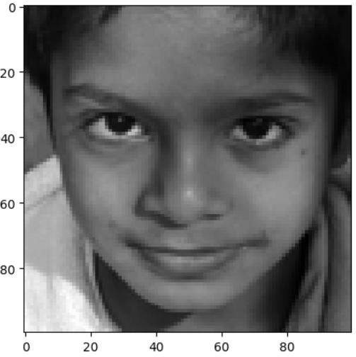
Machine Learning Model
– Pre-process
Training dataset: 70% of the images
Testing dataset: 30% of the images Resizing all images to 100x100 pixels Grayscaling all images

Slide 24
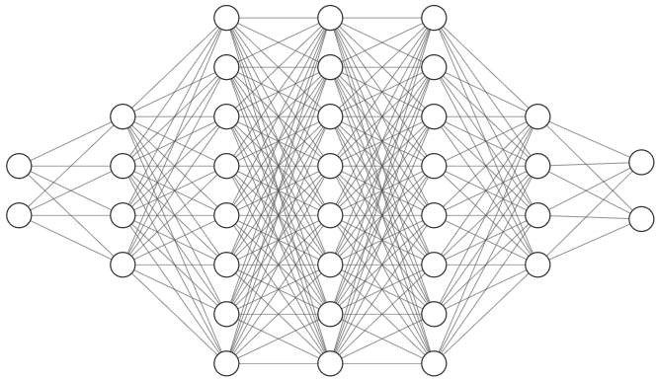
Convolutional Neural Network (CNN)
Happy
Depressed
Input layer
Output
layer

Slide 25
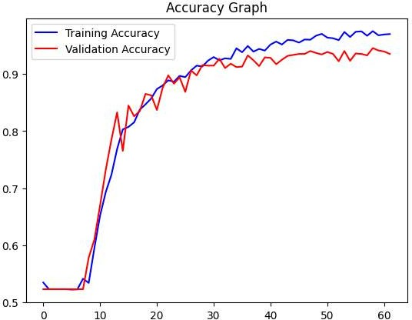
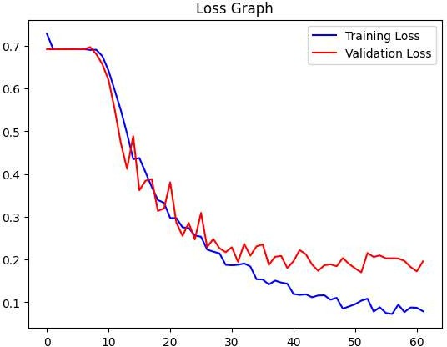
Model Training
Training accuracy: 97%, Validation Accuracy: 94%
Training loss: 8%, Validation loss: 20%

Slide 26
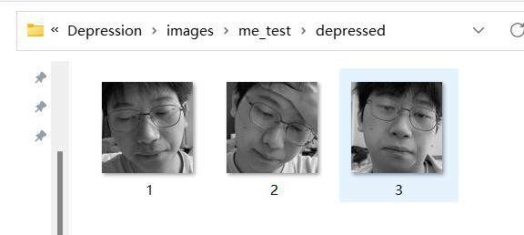
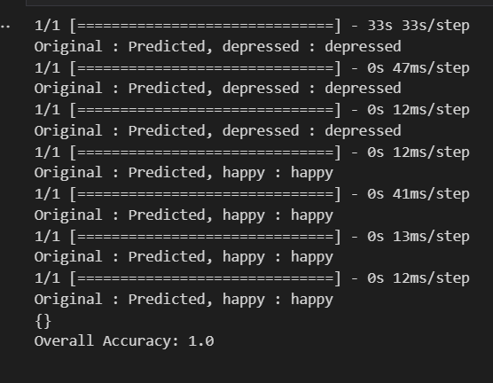
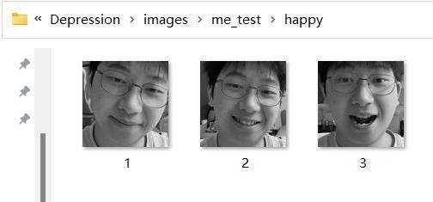
Model Testing
Testing with my selfies
Achieving 100% accuracy

Slide 27


Packaging the system into an API Configuring the RESTful services Setting up Render environment Solving Libraries incompatibility Deploy the API
MACHINE LEARNING API

Slide 28
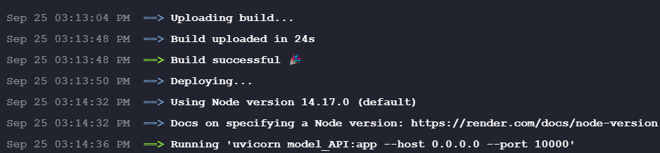
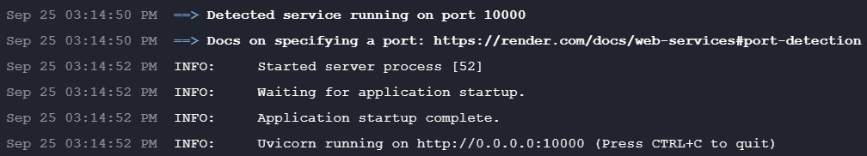
MACHINE LEARNING API
Upload and deploying the API on Render

Slide 29

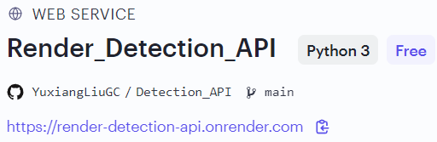
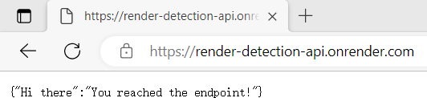
MACHINE LEARNING API
Testing the API by sending HTTP GET request
Receiving predefined greeting

Slide 30
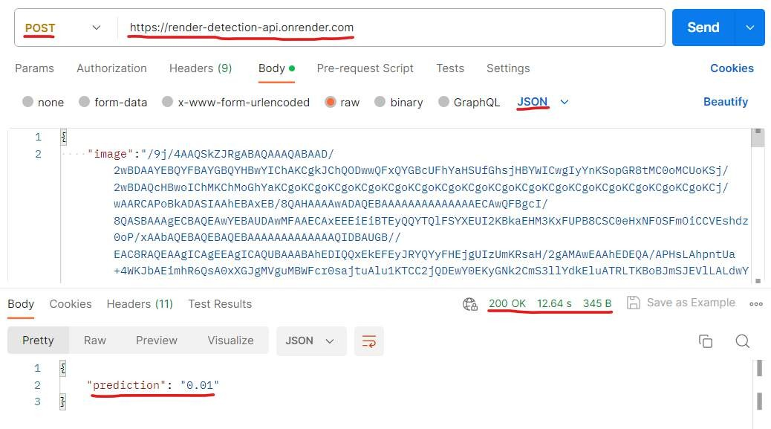
MACHINE LEARNING API
Testing the API by sending an
HTTP POST Request
Along with an image encoded in
base 64 format
Receiving response with a prediction for the probability of depression

Slide 31

SPRINT 1 RECAP
Issue type | Key | Name
STRES-1 | task | Establish teamwork agreement
STRES-2 | task | Establish team roles
STRES-6 | task | Work on deliverable 1 presentation.
STRES-5 | task | Establish weekly meeting
STRES-3 | task | Set up development tools

Slide 32
SPRINT 2 RECAP
Issue type | Key | Name
STRES-8 | story | As a customer, I want to register myself to the application So That I can keep account private and login using email/phone and password
STRES-9 | story | As a customer, I want to login and see the user page
STRES-11 | story | As a customer, after login I want to store all my information
STRES-12 | story | As a signed-in customer, I want to log out So that I can have my privacy in the app.
STRES-14 | task | Create MVP Prototype

Slide 33
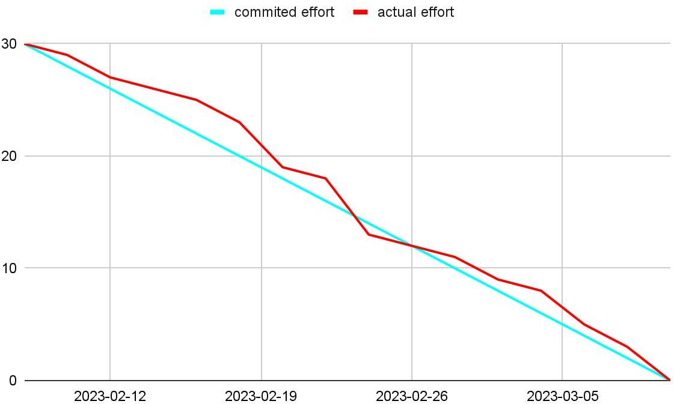
SPRINT 2 BURNDOWN CHART

Slide 34
SPRINT 3 RECAP
Issue type | Key | Name
STRES-20 | story | As a customer, I want to create my profile. So that I can store my basic information
STRES-19 | story | As a customer, I want to browse all the services provided by the app, So that I know what to do next after login
STRES-25 | story | As a customer, I would like to have a landing page explaining all the features of the platform
STRES-27 | story | As a customer, I want to take the picture. So that I can start to analyze my mood
STRES-22 | story | As a signed-in customer, I want to see some recommendation for my mental health

Slide 35
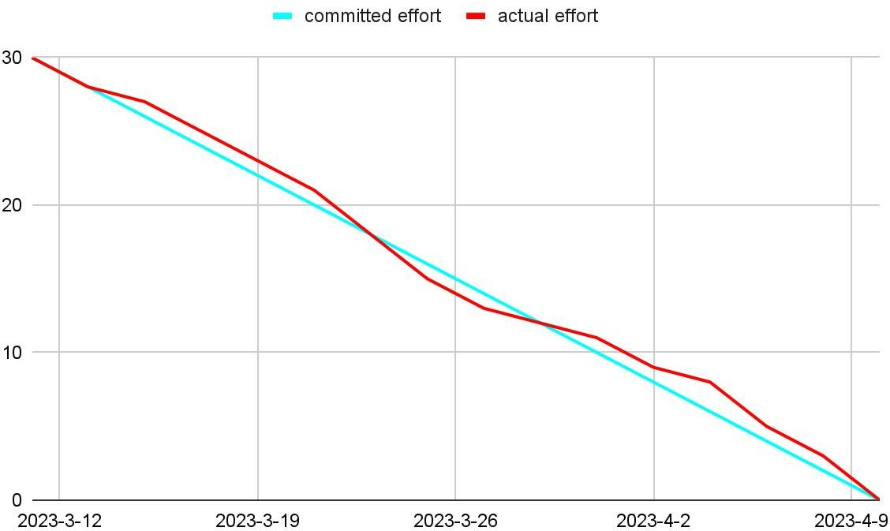
SPRINT 3 BURNDOWN CHART

Slide 36
SPRINT 4 RECAP
Issue type | Key | Name
STRES-26 | story | As a signed-in customer, I want to upload pictures from my phone, so that I can finish my profile
STRES-38 | story | As a customer, I want to take the quiz, so that I can understand my state of mind right now
STRES-30 | story | As a customer, I would like to track my mood, so that I know the state for the whole week
STRES-32 | story | As a customer, I want to be encouraged to track the mood, so that I may not forget to take a self-assessment
STRES-32 | task | Work on technical paper
STRES-35 | story | As a customer, I want to edit my profile, so that I can update my information

Slide 37
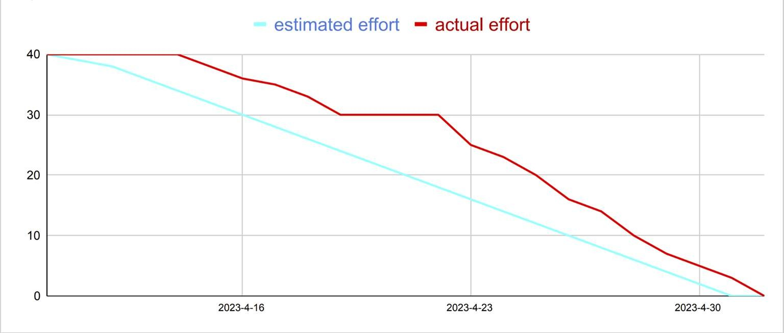
SPRINT 4 BURNDOWN CHART

Slide 38
SPRINT 5 RECAP
Issue type | Key | Name
STRES-40 | task | Deploy the ML model API on Render
STRES-53 | task | As a customer, I want to my results to be saved in the firebase
STRES-48 | task | Improvement the UI of the app
STRES-55 | task | Saving User Images to the firebase storage
STRES-42 | story | As a customer, I want to add note to my pictures, so that it can help me to remember important details

Slide 39
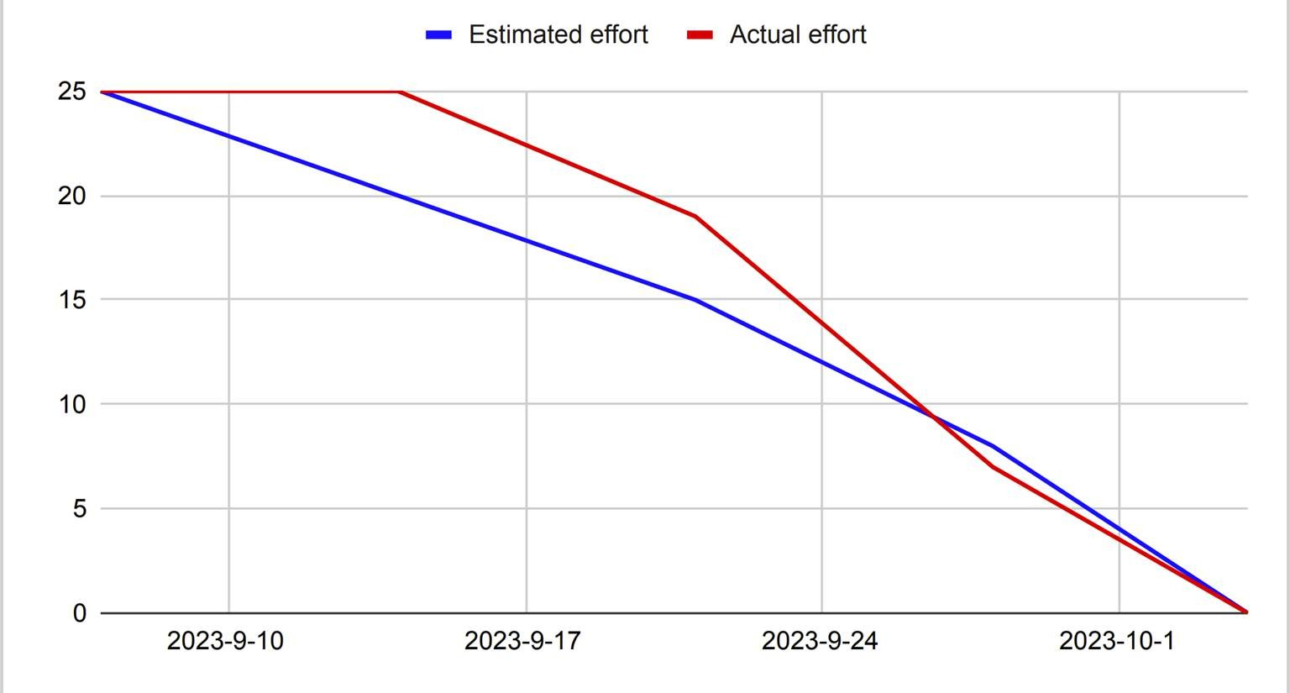
SPRINT 5 BURNDOWN CHART

Slide 40
SPRINT 6 RECAP
Issue type | Name | Story points
STRES-60 | Make an API Call | 5
STRES-61 | As a customer, I want to an app to save and update my details automatically | 5
STRES-50 | Improvement the UI of the app | 5
STRES-57 | As a customer, I want my picture to be resized automatically without resizing it myself | 5
STRES-62 | Improving database on firebase | 5

Slide 41
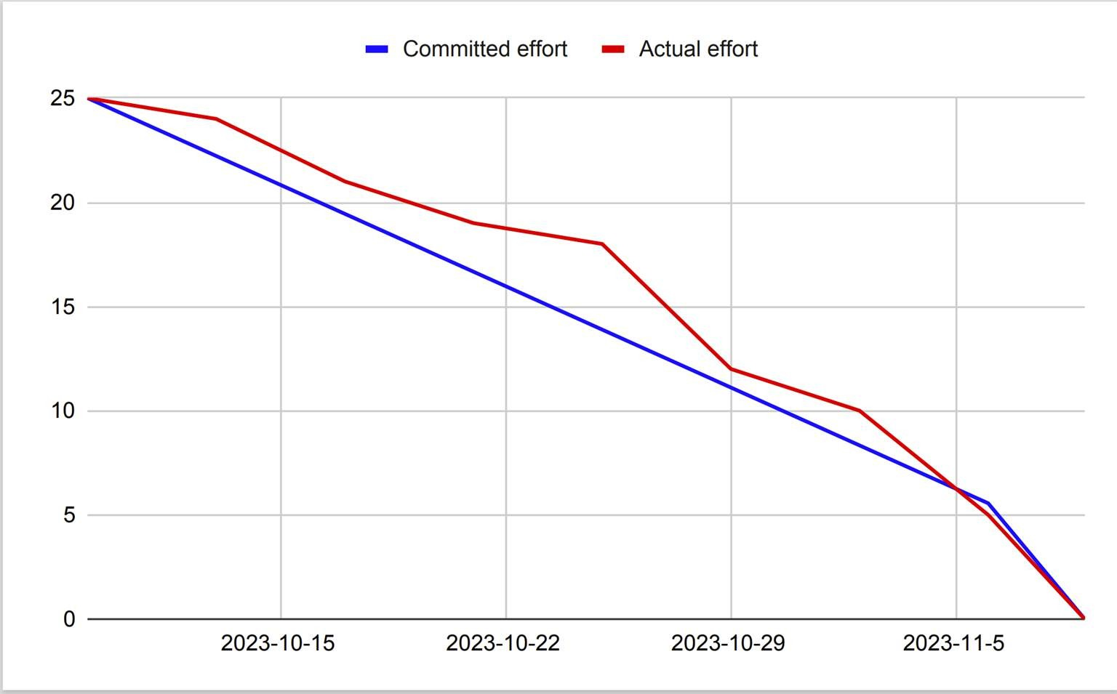
SPRINT 6 BURNDOWN CHART

Slide 42
SPRINT 7 BACKLOG
Key | Name | Story points
STRES-63 | Improve the UI of the app | 5
STRES-59 | As a user, I want an app to display correct information across all pages | 5
STRES-58 | As a user, I want to see results of analysis within 2 seconds after providing picture | 5
STRES-65 | As a user I want to see the instruction for the analyze image | 5
STRES-66 | Finish the technical paper | 5

Slide 43
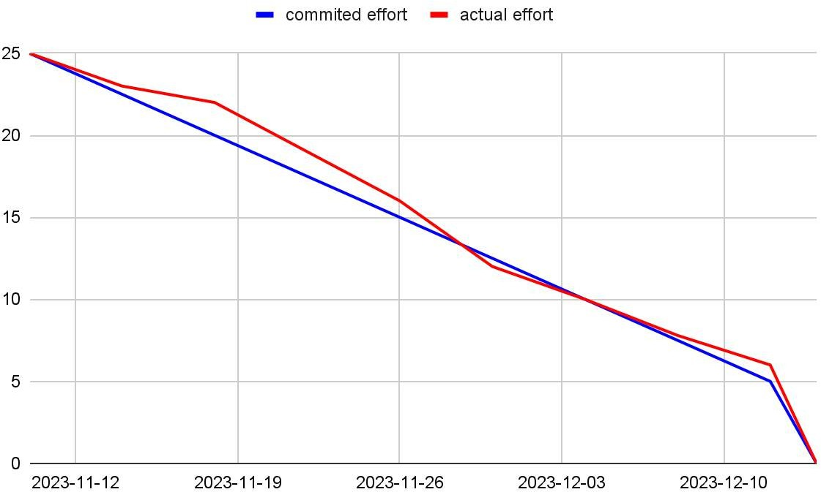
SPRINT 7 BURNDOWN CHART

Slide 44
TEST CASES
Test case for | Key | Test case id | Test data | Expected results | Actual results | Pass/fail
User page | STRES-65 | Test-75 | email:test@gmail.com password:test123 | Customers can know how to see the instruction | After login , question mark is shown behind the analyze button | P
User page | STRES-65 | Test-76 | email:test@gmail.com password:test123 | Customers can read the instruction | Click the question mark button, the page show the instruction | P
Analyze image | STRES-59 | Test-68 | email:test@gmail.com password:test123 one of the photo from phone | Customers can see the image is analyzing | Click the analyze image button, app shows analyzing and the loading circle | P
History page | STRES-58 | Test-62 | email:test@gmail.com password:test123 quiz grade | Customers can check the past result | Click the history and click other details, show the previous quiz grade | P
Take picture page | STRES-55 | Test-64 | email:test@gmail.com password:test123 | After customers take pictures, pictures will be stored and found | Take the picture, it showed in history and can be found in firebase storage | P

Slide 45
Stories / tasks Completed and not completed
Key | Name | Status
STRES-63 | Improve the UI of the app | Done
STRES-59 | As a user, I want an app to display correct information across all pages | Done
STRES-58 | As a user, I want to see results of analysis within 2 seconds after providing picture | Done
STRES-65 | As a user, I want to see the instruction for the analyze image | Done
STRES-66 | Finish the technical paper | Done

Slide 46
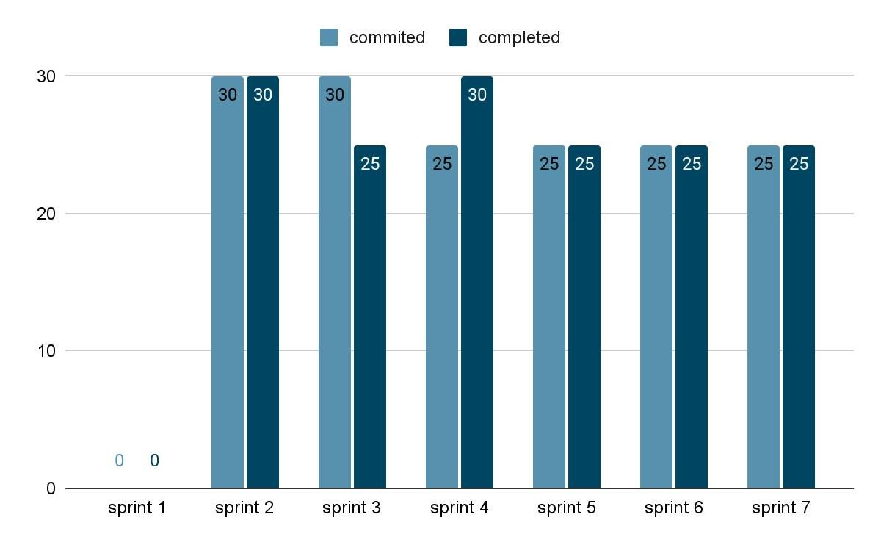
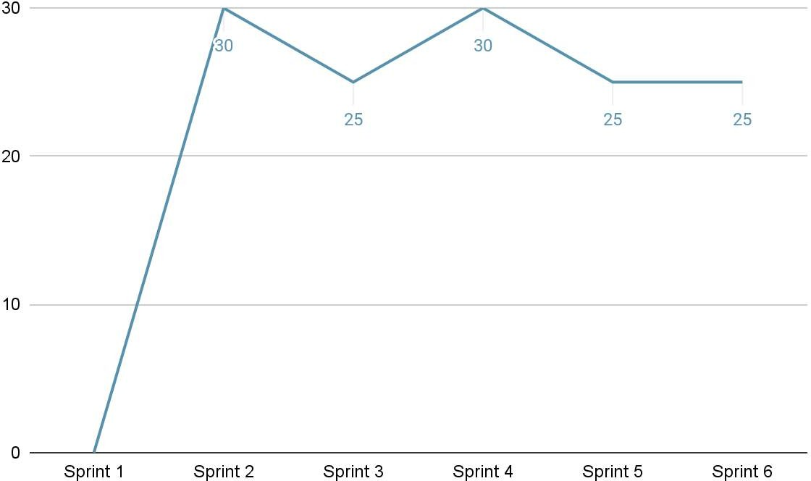
TEAM’S HISTORICAL VELOCITY
(AVERAGE)
average line

Slide 47
PRODUCT BACKLOG
User Stories
Key |  | Summary | Place
 | STRES-19 | As a user, I want to register myself to the application. So that I can keep my account private and login using email/phone and password. | Home Page
STRES-20 |  | As a user, I want to login in app. So that I can use it to store all my information. | Home Page
STRES-42 |  | As a user, I want to upload my picture from phone gallery to analyze so that get more accurate information. | Image Upload/Take Picture
STRES-22 |  | As a user, I want to take a picture from my front and back camera to upload so that the app can analyze | Image Upload/Take Picture
STRES-23 |  | As a user, I want to view my upload history and their results | Profile/History of consultation
STRES-24 |  | As a signed in user, I want to log out So that I can have my privacy in the app. | Logout/Login
STRES-25 |  | As a user I want to be able to find contacts for professional help | Recommendation
STRES-26 |  | As a user I want to be able to view history of my recommendation | Recommendation
STRES-27 |  | As a user, I want to create my profile So that I can store my account information. | Profile/History of consultation
STRES-28 |  | As a user, I want to be able to edit my information detail | Profile/History of consultation
STRES-29 |  | As a user I want to be able to add captions for pictures I have uploaded | Image Upload/Take Picture
STRES-30 |  | As a user, I want to be able to view personalized tips and strategies for managing symptoms | Recommendation
STRES-31 |  | As a user, I want to know the sign of depression, and the risk of depression | Recommendation
STRES-48 |  | As a user, I want to link to the hospital so that I can make a appointment with doctor | Recommendation
STRES-52 |  | As a user, I want the app to keep checking my depression level so that I know when my depression level is worse | Profile/History of consultation
STRES-34 |  | As a user, I want to know the risk of depression about me after I take pictures | Image Upload/Take Picture
STRES-35 |  | As a user, I want to know some tips for relieving depression so that I can become better | Recommendation

Slide 48
PRODUCT BACKLOG
User Stories
Key | Summary | Place
STRES-59 | As a user, I want an app to display correct information across all pages | Home Page
STRES-58 | As a user, I want to see results of analysis within 2 seconds after providing picture | Home Page
STRES-65 | As a user, I want to see the instruction for the analyze image | Image Upload/Take Picture
STRES-61 | As a customer, I want to an app to save and update my details automatically | Image Upload/Take Picture
STRES-57 | As a customer, I want my picture to be resized automatically without resizing it myself | Profile/History of consultation

Slide 49

STORIES AND ACCEPTANCE CRITERIA
Scenario | User Story | Status
1. customers want to know how to analyze their images Given I’m in the role of customer When I open the app Then I want to see how to analyze the image And I click the question mark Then I can see the instruction | As a customer I want to know how to analyze the image so that I can know which kind of pictures I should upload | Done

Slide 50
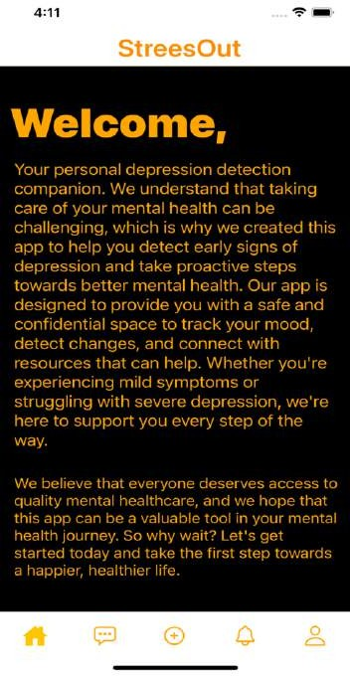
APP SCREENSHOTS
Home Page
App has 5 Functionality Buttons
Onboarding Screen: A screen that welcomes the user to the app and provides an overview of its app.
Stress level analysis screen: A screen that displays the user's stress level based on the biometric data collected.
Quiz / Upload Images Screen: Quiz screen that asks the user questions to identify their sources of stress. Upload screen that allows the user to upload images
Stress management techniques Screen: A screen that provides stress management techniques, such as breathing exercises, meditation, or cognitive behavioral therapy.
Registration / Login Screen: A screen that allows the user to create an account or log in to an existing one.

Slide 51
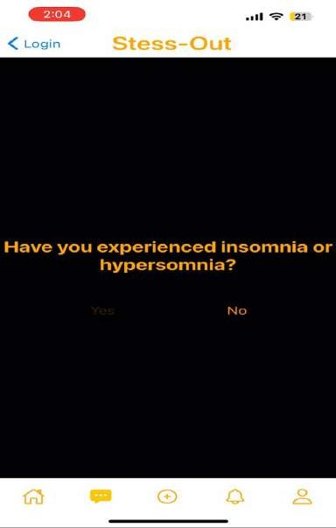
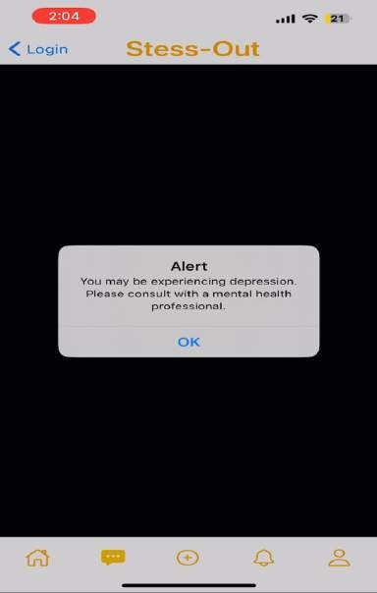
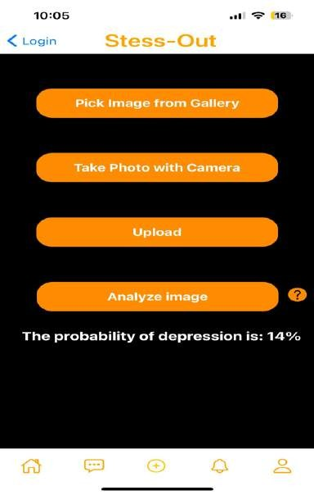
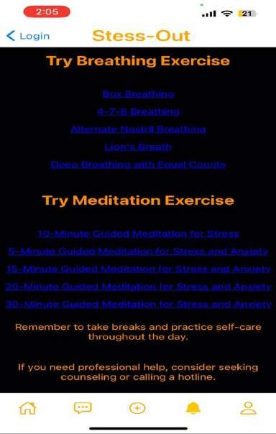
APP SCREENSHOTS

Slide 52
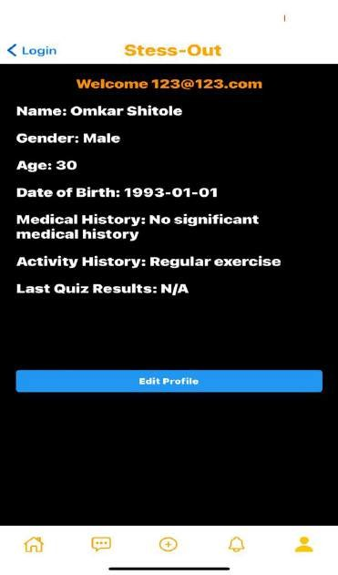
USER DETAILS
Profile Screen
In this screen user can edit and save profiles information like name, gender, age, DOB, medical history, and activity history.
User quiz results are saved in real-time to a Firestore database as
part of their profile data.
The app's profile screen provides a comprehensive overview of the user's personal information and quiz results, aiding in stress assessment.
By combining facial recognition technology and profile data storage, the app aims to offer effective stress detection and management.

Slide 53
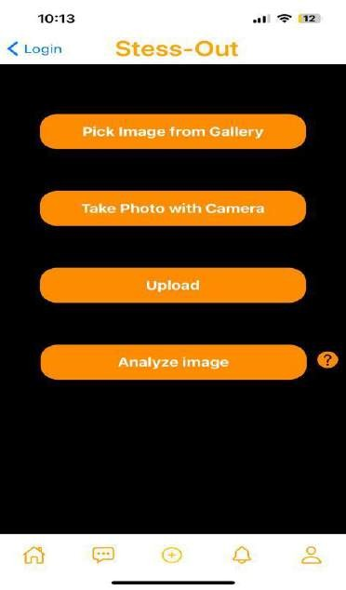

INSTRUCTION
In Stress-Out app, there is a question mark
symbol next to the "Analyze Image" button. When users click on this symbol, an instruction page is displayed, providing guidance on how to upload a photo and specifying the recommended angles for the photos. The instructions also include dos and don'ts for the users to follow.

Slide 54


FIREBASE AUTHENTICATION
When a new user creates an account using Firebase Authentication in our app, the user's email address and a unique user ID (UID) are automatically generated and stored securely in the Firebase Authentication server.

Slide 55

FIREBASE AUTHENTICATION
When a user uploads or takes a picture
in our app, the image is
Firebase Storage using the
stored in
Firebase
Storage client SDK. To maintain a separation between different users' data, we create a separate folder for each user in Firebase Storage, with the user's UID associated with that folder. This ensures that each user's data is stored in separate location. Firebase Storage generates a unique URL for each file that is stored, which can be used to retrieve the file later.

Slide 56

RETROSPECTIVE
What went well: Team has quickly introduced all the improvements and finished working on the app.
What needs improvement: The team needs to be more ambitious with future tasks. We must be focused on adding new features for the future.
Next Steps: We plan to review our app and attempt to push project further.

Slide 57

Plans for future
improvement
Introduction of reinforcement learning to the model – this will enable constant improvement of accuracy for any given individual.
Introduction of video conferencing with mental health professional – the app should strive to become one stop shop for people to diagnose and solve their mental health issues
Posting app on google play and app store – release the app to the public

Slide 58

THANK YOU
Wiki page link
Updated Technical Paper Deployment Manual Link

